Slide 1


Overview and New Features of Visual Studio 2019
Vignesh Mani,
Speaker, Author, C# Corner MVP,
Senior Software Engineer,
Capgemini India Pvt Ltd.

Slide 2
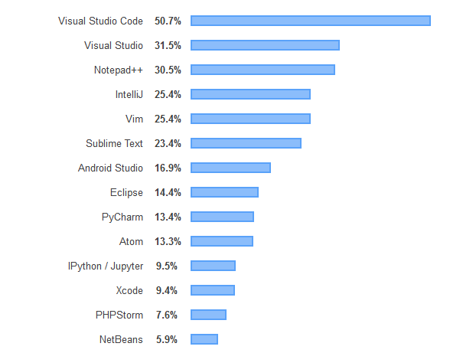
Most Popular Development Environments

Slide 3
What can you do with Visual Studio?

Slide 4
You can build any
App,
Game,
Extension using any language.
Learn about the features
Productivity,
Improve code quality,
Add to team agility.

Slide 5
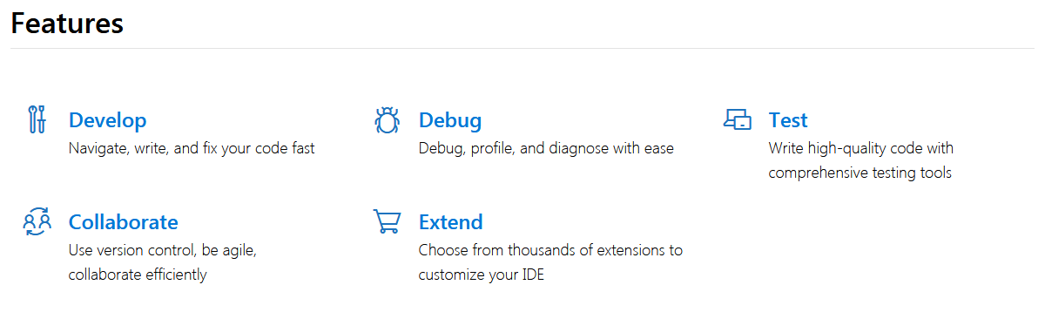

Slide 6
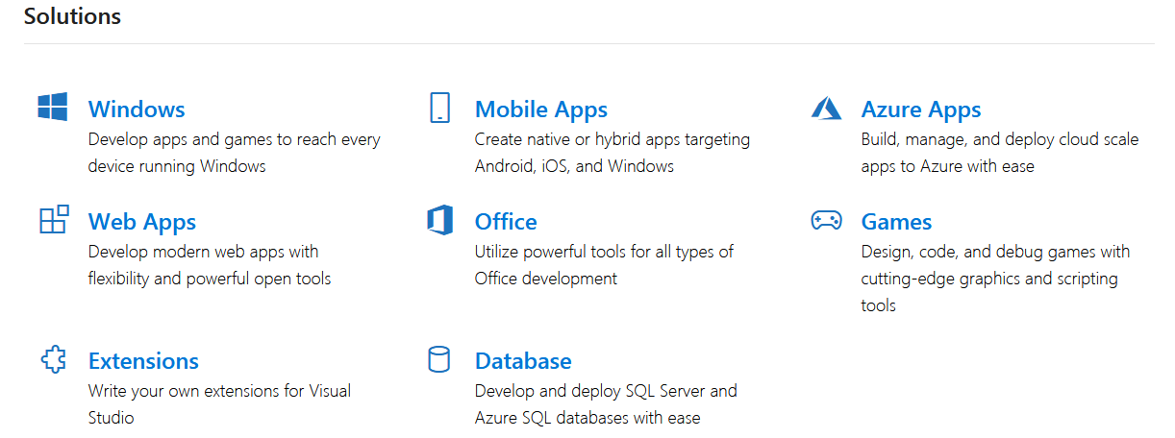

Slide 7
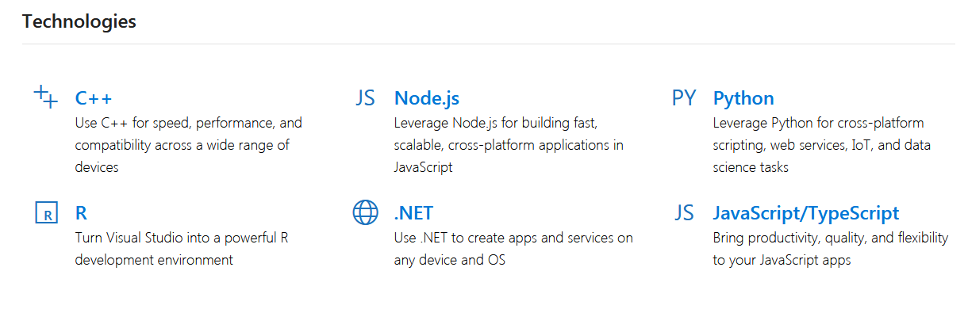

Slide 8
NEW USER INTERFACE LOOK

Slide 9
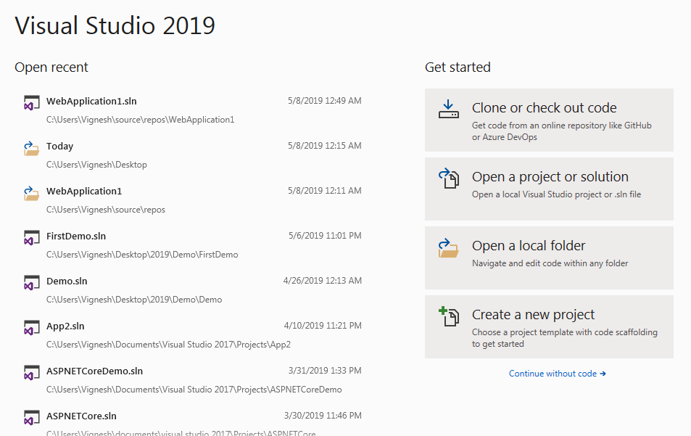

Slide 10
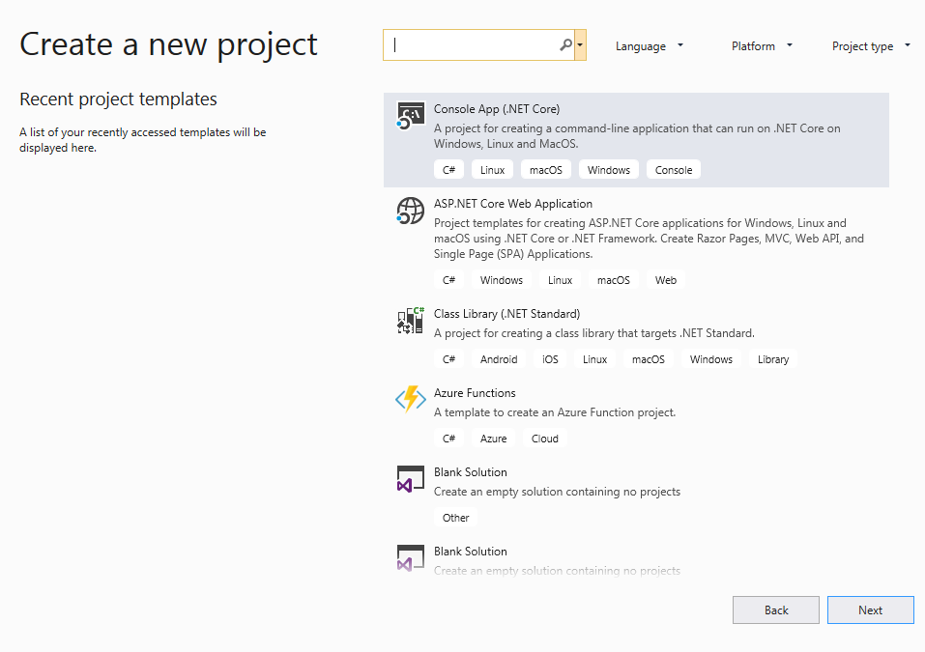

Slide 11
New Search Experience

Slide 12
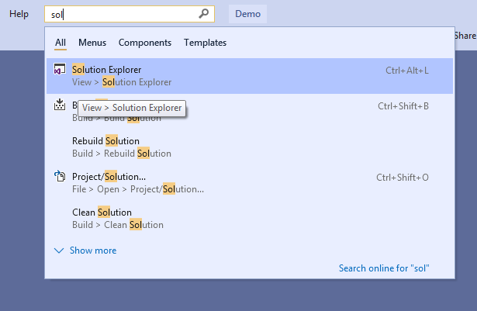

Slide 13
New Features In Copy and Paste

Slide 14
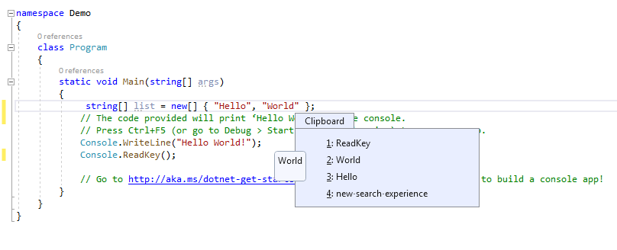

Slide 15
Refactoring “The process of restructuring existing computer code”

Slide 16
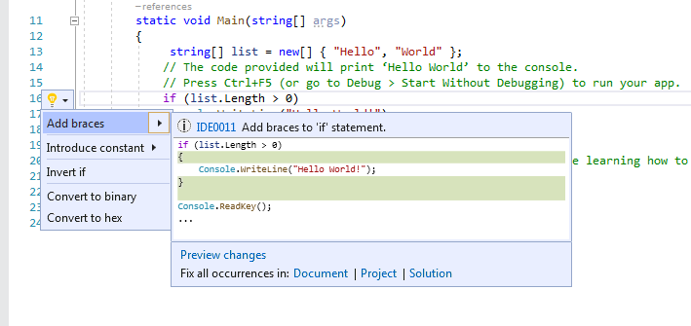

Slide 17
IntelliCode

Slide 18
“Visual Studio IntelliCode is an extension that enhances your software development efforts by using artificial intelligence (AI)”.
“IntelliCode trains across 2,000 open-source projects on GitHub each with over 100 stars to generate its recommendations”.

Slide 19
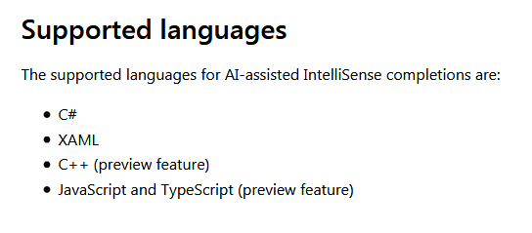

Slide 20
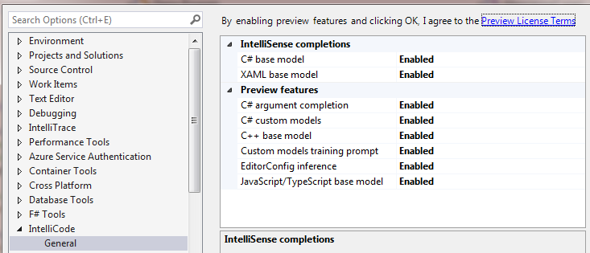
Install IntelliCode Extention
https://marketplace.visualstudio.com/items?itemName=VisualStudioExptTeam.VSIntelliCode
Enable IntelliCode

Slide 21
Search While Debugging

Slide 22
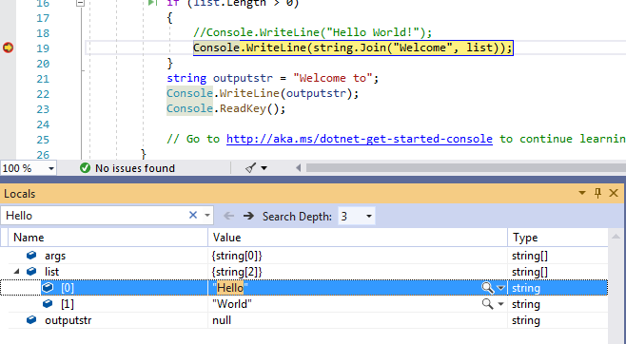

Slide 23
Code Cleanup

Slide 24
Do Not Load Project

Slide 25
Live Share

Slide 26
“When you need to collaborate, Live Share will instantly share your project with a teammate. Edit and debug together in real time without teammates needing to clone a repo or set up their environment.”

Slide 27
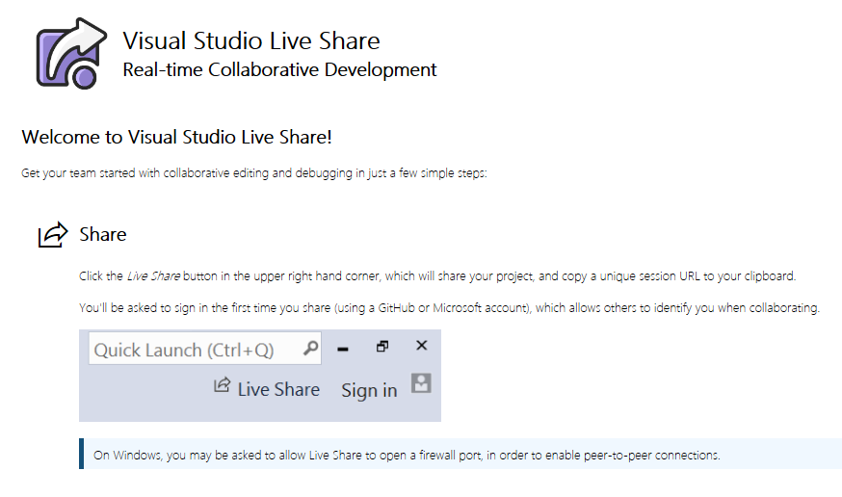

Slide 28




Contact
+91 9788004734
mcavickymas@gmail.com
@mcavickymas
SinfoV Tech

Slide 29
Thank You To All

